Slide 1


The role of real-time data in ending homelessness
Insights from Denmark

Slide 2


Who am I?
Louise Marie Pedersen
Founder & Director
Social Anthropologist

Slide 3
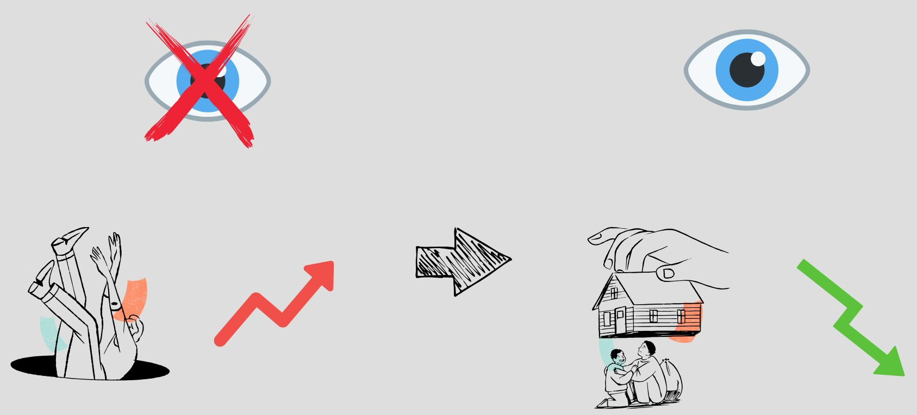
The problem and the solution

Slide 4
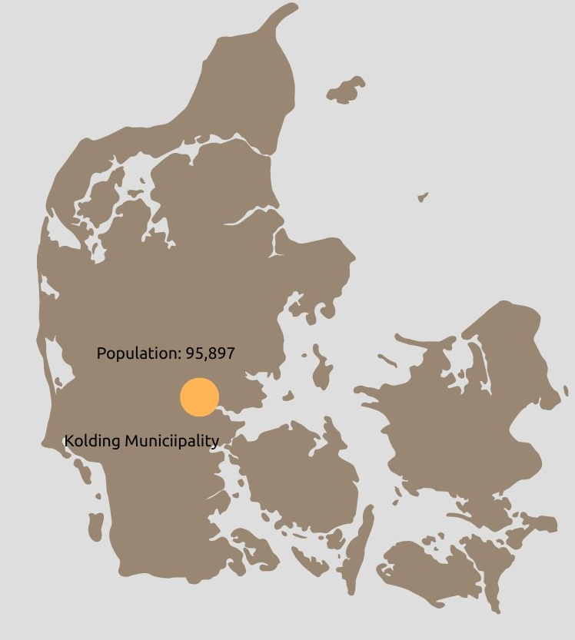



Case Study: Real-Time data in the municipality of Kolding, Denmark​

Slide 5
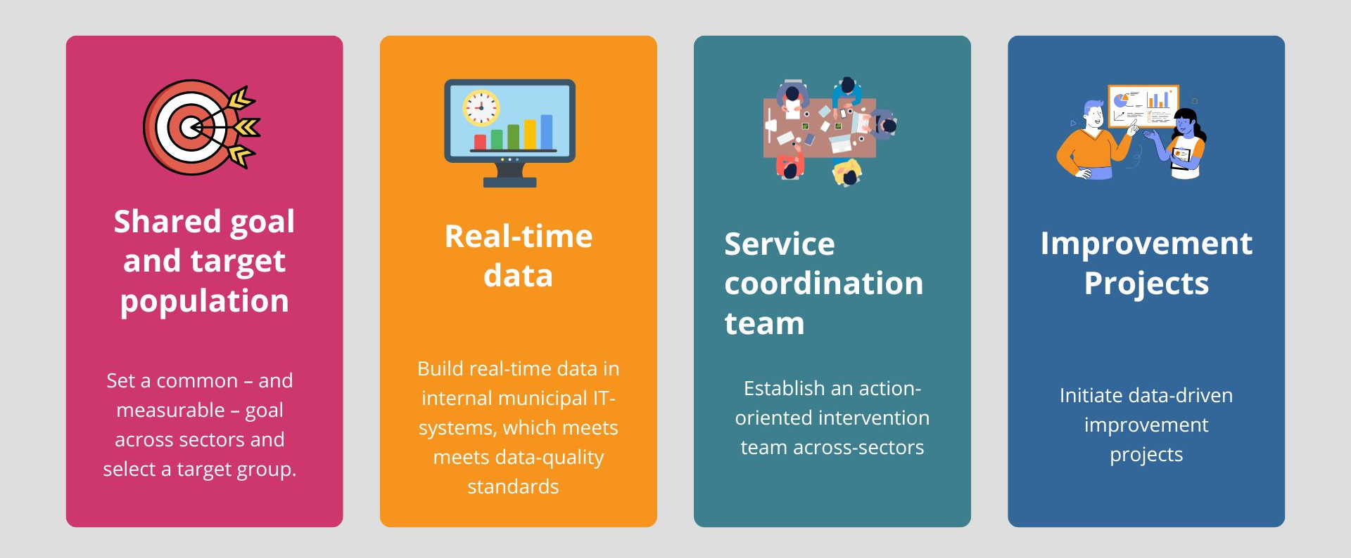
The core elements

Slide 6







The core of real-time data
PEOPLE EXPERIENCING HOMELESSNESS
PRE-INFLOW
INFLOW
OUTFLOW
INFLOW:
Newly Identified
INFLOW:
Returned from housing
INFLOW:
Returned from inactive
OUTFLOW:
Housed
OUTFLOW:
No longer meets target group criteria, deceased, no contact in 90+ days
At
risk

Slide 7

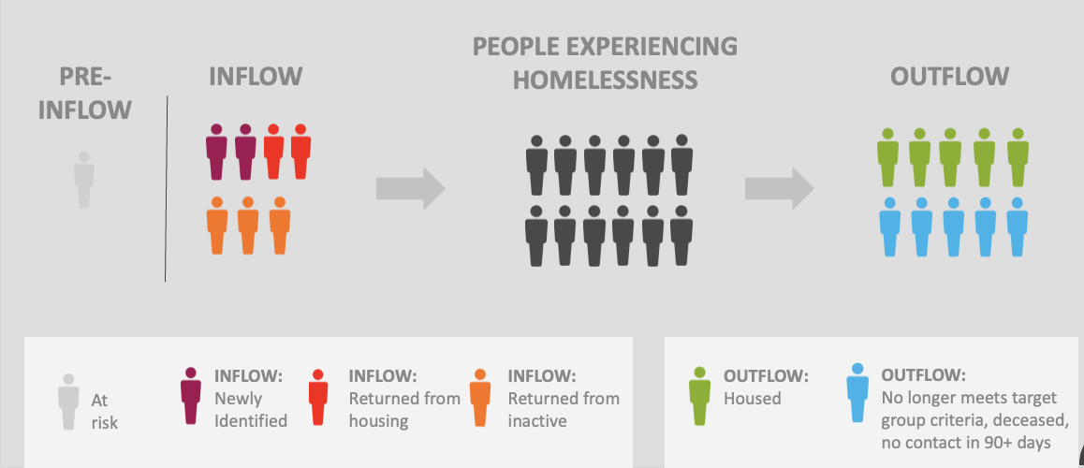
Two levels of real-time data

Slide 8
Two levels of real-time data
Name | Age | Status | Situation | Housing need | Support | Critical barrier to housing
Andy | 45 | New | At risk | Avoid eviction | ICM | Critical barrier to housing
Mandy | 20 | Returning | Couch surfing | 2.500, Kolding, dog, 1st floor | CTI | Conflicts with landlords and neighbors
Thomas | 50 | New | Shelter | 4.000, Randers, shared home | Declined | Lack of affordable housing
Sarah | 23 | New | Shelter | 3.500, countryside, ground floor, 3 dogs | ICM | Deposit loan application declined
Alice | 34 | Returning | Street | 4500, Aalborg, 2 children, 2 rooms | ACT | Sanctions from employment department
Steve | 44 | New | Shelter | 2.5000, Kolding, elevator, 2 cats | CTI | Long waiting time for deposit loan
Carl | 54 | Returning | Street | 3.000, Esbjerg, 1 room | ICM | Cannot afford membership in housing association
Nick | 42 | Returning | Couch surfing | 3.500, Kolding, shared, 3 rooms | M-ACT | Difficult to motivate the person to move in
Mohammad | 30 | New | At risk | Aviod termination own tenancy | Declined | Hard for support worker to establish dialogue
Hannah | 27 | New | Street | 2.500, Kolding | ICM | Lack of required documentation (ID, income proof)
Kelly | 18 | Returning | Shelter | 3.500, Kolding | ACT | Criminal record that limits housing access

Slide 9
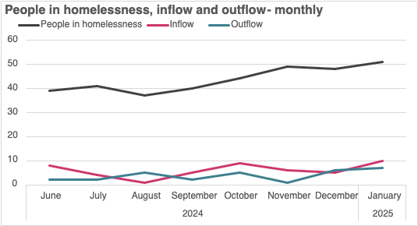
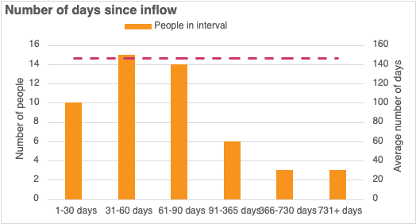
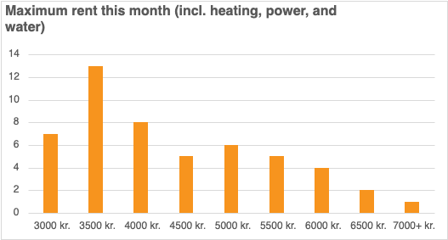
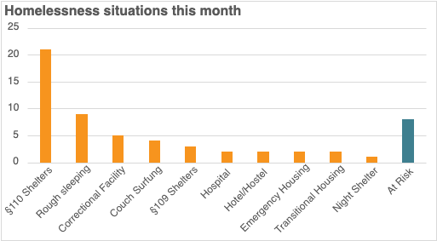
Two levels of real-time data

Slide 10
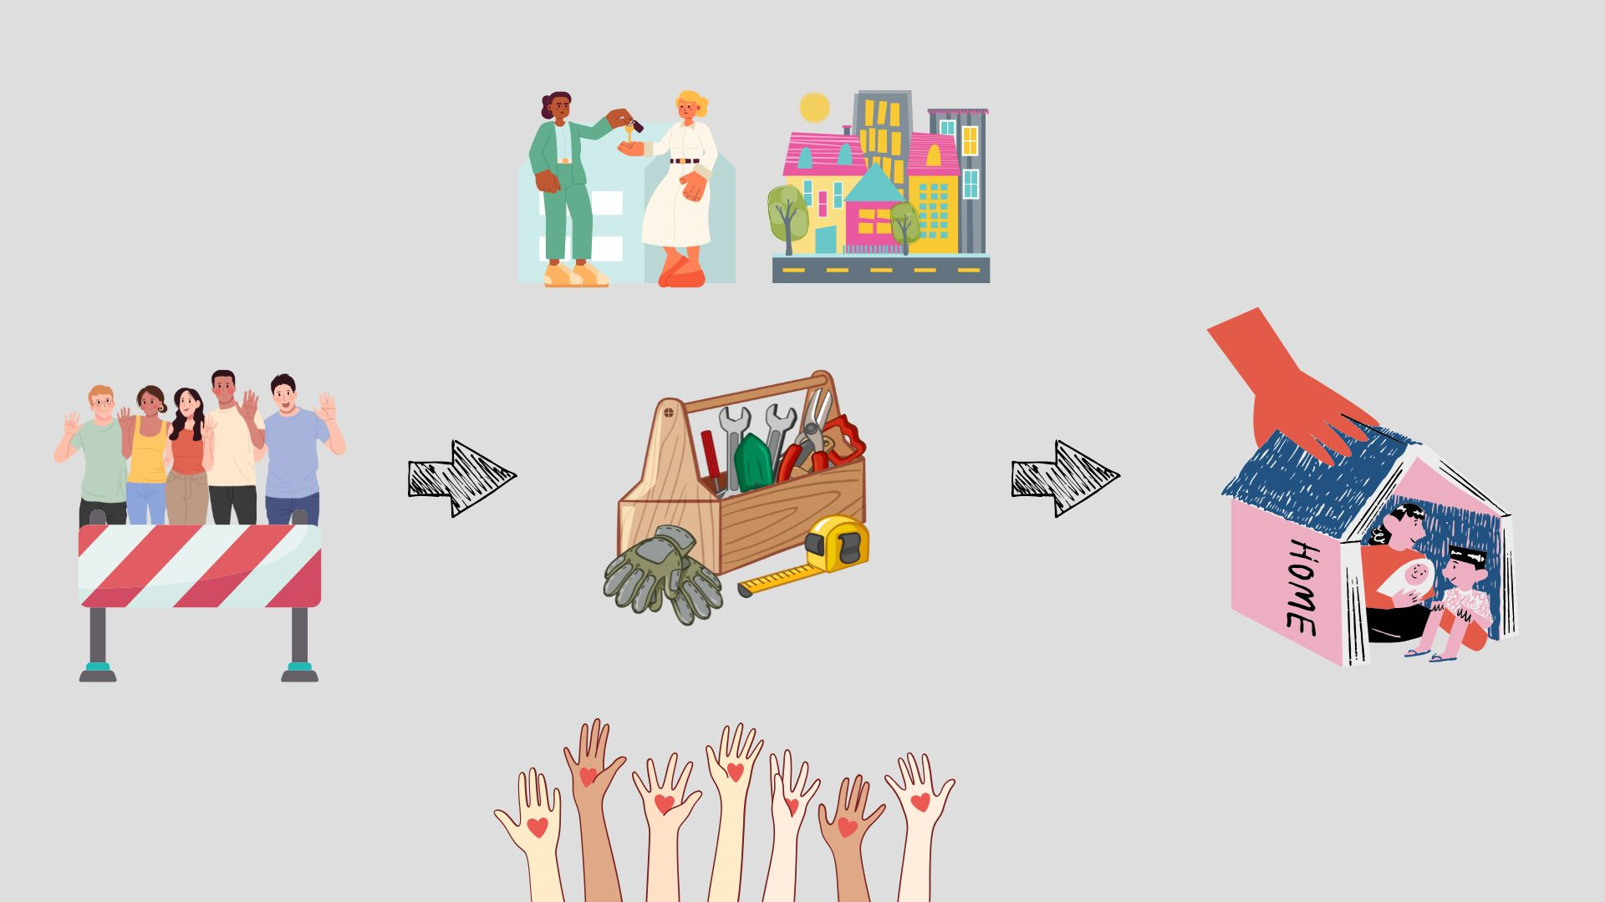
Changing the system with real-time data insights

Slide 11
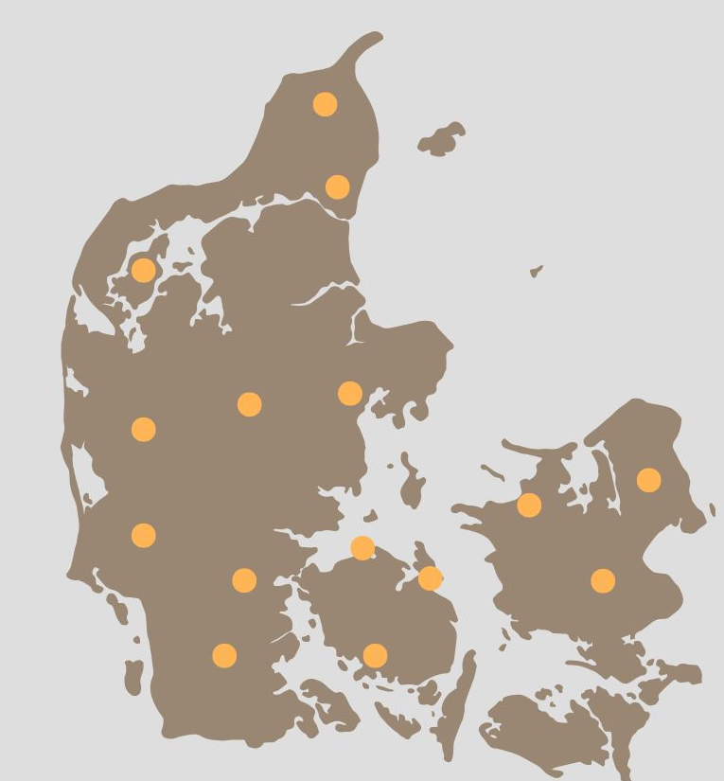
Changing the system with real-time data insights

Slide 12
Housing first conference, Gothenburg 2025
Survey the homelessness – The City of Gothenburg
Emma Bittone, Land Development Department​
2025-09-16
Notes:
My name is Emma Bittone. I work as a planning manager at Land Development Department, here in the city.

Slide 13

Agenda
Mapping homelessness in Gothenburg
Method
Challenges and Key factors
Notes:
These are the main subjects I will address in my presentation

Slide 14

Mapping homelessness
Conduct annual surveys
Based on the European Typology on homelessness and housing exclusion (ETHOS)
The purpose of the survey is to measure the extent and development of homelessness
The results are used to meet the needs of homeless people
As part of the follow-up of the City’s action plan for homelessness
Notes:
Every year, during one week in April, the cities social workers fill out a survey.
The survey counts the number of households in the four types of homelessness, according to the National Board of Health and Welfare’s definition. (Socialstyrelsen)
That´s based on ETHOS (European Typology on homelessness and housing exclusion) framework developed to improve the understanding and measurement of homelessness across Europe.
The purpose of the survey is to see how many homeless households there are and what the future needs for accommodation and support are. The results are then used for planning support and help for people who are homeless.
The survey is also part of the follow-up of the city’s action plan for homelessness.

Slide 15
Four situations of homelessness
1. Acute homelessness
Acute accommodation
2. Institutional stay or similar – moving within 3 months without a place to live
Prison
3. Long-term housing solutions – housing arranged by the social services
Long-term social housing with support
Sheltered accommodation
Public premises
Outdoors
Tent
Car
4. Self-arranged short-term accommodation – maximum three months after the measurement period.
Subletting second-hand
Treatment centre
Supportive housing
Municipal contract
Temporary accommodation with friends, acquaintances or family
The Swedish National Board of Health and Welfare
Notes:
These are the four situations of homelessness according to the Swedish National Board of Health and Welfare (Socialstyrelsen). Witch is based on ETHOS framework
1. Acute homelessness
2. Institutional stay or supported living, short-term of 3 months.
3. Long-term housing solutions arranges by the social services
4. Self-arranged short-term housing, shorter than 3 months.
The city has based it´s surveys on these four situations of homelessness for the last 10 years.

Slide 16

Not included in the definition
Children under 18, who live outside their home
People in special service housing
People in prison or treatment centre who already have housing arranged
People staying in Sweden without permit
Newly arrived emigrants who get housing from the municipality
Notes:
However there are some households that are not included in the definition.

Slide 17

Method
BoInvent1
Social workers within the Social welfare-, Functional support- and Eldercare and Welfare administration fill out:
  background information,
  family situation
  causes of homelessness
  current situation
  future needs for housing and support
Conducted every year (every 6:e year a national survey by the Swedish National Board of Health and Welfare)
Notes:
The social workers in the city´s four Social Welfare- , functional support and eldercare and welfare administration fills out a survey, on for each household in a system called BoInvent1.
They answers questions about the households' background information, family situation, causes of homelessness, current situation and future needs for housing and support – in the near future.
The survey conducts for one week in April.

Slide 18
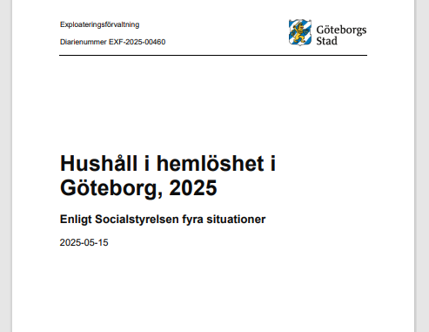
Report
Team with relevant knowledge to analyze the data
The results are gathered in a report
Part of the follow-up of the City’s action plan for homelessness
The results are used for planning support and accommodation
Notes:
Afterwards the survey closes, and a team analyses the data.
The results are then gathered in a report.
The results is part of the follow-up of the Citys action plan for homelessness and used for planning support and accommodation.

Slide 19

Challenges and Key factors
Only the household in contact with the social services
The survey fills out in another system
Measuring period is short - one week
Using the European Typology of Homelessness and Housing Exclusion (ETHOS)
Conducts annually – ten years of results
Follow up on the targets of City´s plan of action to reduce homelessness
Source for planning support and accommodation for people in homelessness.
Notes:
Challenges:
Since the social services are conduction the survey, we are only able to measure the households in contact with the social services.
The social workers have to fill out the survey in another system which requires time and effort.
The City only conduct he survey for one week each year
Has it been possible to extract the numbers from the ordinary journal system, we could be doing follow-ups on a regular basis
Key factors:
Using a method to measure homelessness that’s based on ETHOS definition that’s similar and comparable to European measurements.
Ten years of results in the City to analyse.
The survey is used to follow up on the City´s plan of action to reduce homelessness – to see if the strategies in the plan reduce homelessness as planned.
It´s also an opportunity to plan support and accommodation for the near future.

Slide 20
Contact
Emma Bittone
emma.bittone@exploatering.goteborg.se
Land development department, City of Gothenburg
031 – 368 13 57
073 – 666 49 00

